Slide 1
INTRODUCTION
The very purpose and main function of education is the development of an all round and well balanced personality of the students .
The other aspect of their personality like physical, emotional, social and spiritual are not properly developed in providing for the growth of attitudes, habits, values, skills and interests among the pupils. It is here that the importance of Value education comes in.

Slide 2
Objectives of value education
The main objectives of Value education are:
Full development of child’s personality
Inculcation of good manners and of responsible and cooperative citizenship
Developing respect for the dignity of individual and society
Inculcation of a spirit of patriotism and national integration
Developing of a democratic way of thinking and living

Slide 3
What is Deep ecology ?
Deep ecology is an ecological and environmental philosophy promoting the inherent worth of living beings regardless of their instrumental utility to human needs, plus a restructing of modern human societies in accordance with such ideas.
Deep ecology’s core principle is the belief that the living environment as a whole should be respected and regarded as having certain basic moral and legal rights to live and flourish, independent of its instrumental beliefs for human use.

Slide 4

Valuing nature and its ecology
The most fundamental environmental sentiment is to value Nature herself. Appreciating her magnificence and treasuring life itself leads to positive feelings that are a manifestation of pro environmental consciousness. We must appreciate that we belong to a global community that includes another 1.8 million living forms.

Slide 5
Understanding Environmental Ethics
Environmental ethics is the part of environmental philosophy. There are many ethical decisions that human beings make with respect to the environment:
Should humans continue to clear cut forests for sake of human consumption ?
Should humans continue to make gasoline-powered vehicles ?
Is it right for humans to knowingly cause the extinction of a species ?
We should aim to seek answers to the above questions.

Slide 6
What is Culture ?
Culture is an umbrella term which encompasses social behaviour and norms in human societies, as well as the knowledge, beliefs, arts, laws, customs, capabilities and habits of the individuals in these groups.
Humans acquire culture through the learning processes of enculturation and socialization, which is shown by the diversity of cultures across societies.

Slide 7

Valuing Culture
Every culture has a right to exist. Tribal people are frequently most closely linked with Nature and we have no right to foist on them our own modern way of life. The dilemma is how to provide them with modern health care and education that gives them an opportunity to achieve a better economic status without disrupting their culture and way of life. This will happen only if we value their culture and respect their way of life.

Slide 8
What is Social justice ?
Social Justice is a concept of fair and just relations between the individual and society, as measured by the distribution of wealth, opportunities for personal activity, and social privileges.
Social justice is connected with issues of equality and equity.
Social justice is based on the premise that all people are entitled to the same basic rights and freedoms as everybody else.
Social justice assigns rights and duties in the institutions of society, which enables people to receive the basic benefits and burdens of cooperation.

Slide 9
Why Social justice is important?
It ensures that everyone gets the essentials for a good life
It ensures everyone gets adequate healthcare
It protects people from religion-based discrimination, ageism, sexuality-based discrimination
It helps promote equality between genders and economic equality
It helps improve educational opportunities for kids
It defends people from racism.

Slide 10
Human Heritage
The “common heritage of mankind” also known as Human heritage is an ethical concept. It establishes that some localities belong to all humanity and that their resources are available for everyone’s use and benefit, taking into account future generations and the needs of developing countries.
The earth itself is a heritage left to us by our ancestors for not only our own use but for the generations to come. There is much that is beautiful on our Earth - the undisturbed wilderness, a traditional rural landscape, the architecture of a traditional village or town, and the value of a historical monument or place of worship. These are all part of human heritage.

Slide 11
We are all responsible for the heritage
Every day, know-how of excellence disappear, historical anchors dissolve away in new consumption dictats . We are moving away from civilizations century-long traditions, swept along by a rich and abundantly creative world, in an ephemeral goal.
Human Heritage wanted to bring together women and men who have proficiency of very specific and ancestral know-hows, and women and men thirst of culture, history of traditions, and uniqueness.

Slide 12
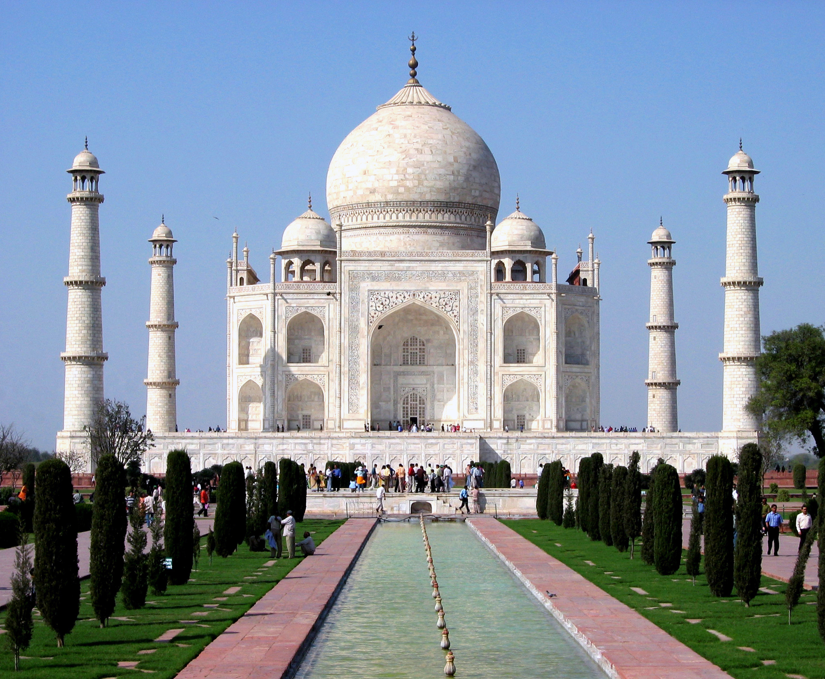
A World Heritage Site is a landmark or area, selected by the United Nations Educational, Scientific and Cultural Organization (UNESCO) for having cultural, historical, scientific or other form of significance, which is legally protected by international treaties. The sites are judged to be important for the collective and preservative interests of humanity.
Taj Mahal, an example of a cultural heritage site.

Slide 13
Equity rights
Equity shares are the main source of finance of a firm. It is issued to the general public. Equity share­holders do not enjoy any preferential rights with regard to repayment of capital and dividend. They are entitled to residual income of the company, but they enjoy the right to control the affairs of the business and all the shareholders collectively are the owners of the company.

Slide 14
Features of Equity Shares
They are permanent in nature.
Equity shareholders are the actual owners of the company and they bear the highest risk.
Dividend payable to equity shareholders is an appropriation of profit.
Equity shareholders do not get fixed rate of dividend.
Equity shareholders have the right to control the affairs of the company.

Slide 15
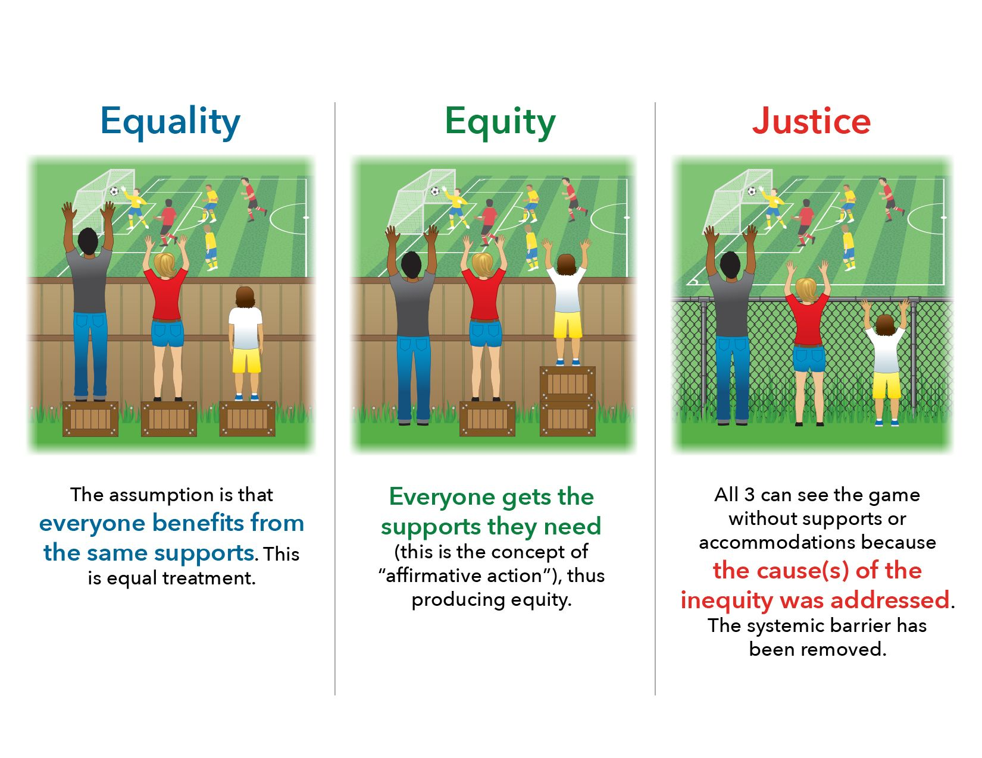

Slide 16
Health as human right
The WHO Constitution (1946) envisages “…the highest attainable standard of health as a fundamental right of every human being.”
Everyone has the right to the health care they need, and to living conditions that enable us to be healthy, such as adequate food, housing, and a healthy environment.
Health care must be provided as a public good for all, financed publicly and equitably.

Slide 17

Importance of Good Nutrition
Reduce high blood pressure
Lower high cholesterol
Improve your well-being
Improve your ability to fight off illness
Improve your ability to recover from illness or injury
Increase your energy level
Reduce the risk of some diseases, including heart disease, diabetes, stroke, some cancers, and osteoporosis

Slide 18
COMMON PROPERTY RESOURCES
Common property resources (environmental) are natural resources owned and managed collectively by a community or society rather than by individuals.
The water that nature recycles, the air that we all breathe, the forests and grasslands which maintain our climate and soil, are all common property resources.

Slide 19
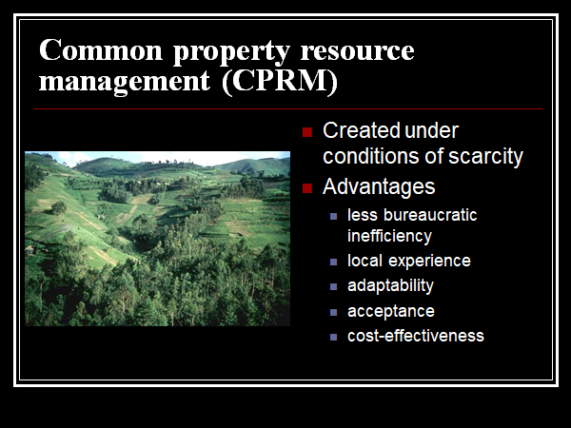

Slide 20
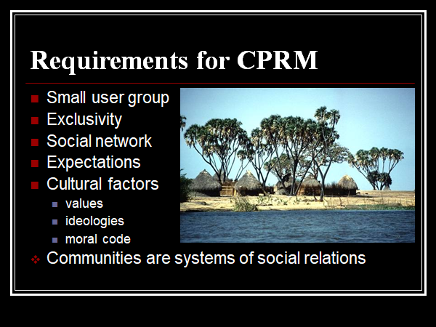

Slide 21
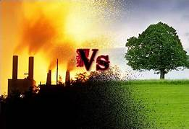
What is ecological degradation ?
Ecological degradation is the overall term for degrading of an entire ecosystem, as distinct from, say soil degradation, which is quite specific.
A degraded ecology has suffered so much harm that it lacks the ability to restore its own health.

Slide 22
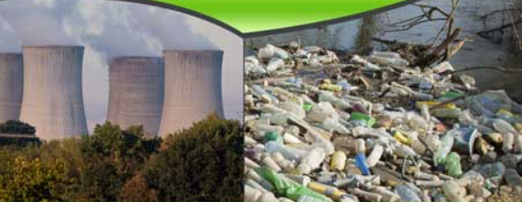
Causes of Ecological degradation
The main causes of ecological degradation are:
Land Disturbance
Pollution
Overpopulation
Landfills
Deforestation
Natural Causes - like avalanche, quakes, tidal waves

Slide 23
PREPARED BY :
Mohit Garg
Stuti Pareek
Karan Aditte Singh
Divyansh Rastogi
Mohit Akhouri

Slide 24
THANK YOU

